Slide 1







Predicting Credit Card Approval

Slide 2





what is the project?
we use machine learning techniques to predict whether credit card applications will be approved or rejected based on a set of data containing customer information."
.

Slide 3










Dataset Description:
"The dataset consists of customer-related information such as age, income, job type, number of children, and other features that may impact the decision-making process."
Showcase the main features (columns) in the dataset such as:
Age, Income, Employment, Credit History, Status, etc.
"The dataset contains 1000 records for each customer and is used for training the model."
Real estate

Slide 4






Data Analysis Steps :
Data Cleaning:
"We cleaned the dataset by handling missing values and removing any invalid data."
"Missing values were either dropped or imputed."
Preprocessing:
"Categorical features were encoded into numeric values using techniques like One-Hot Encoding."
"Normalization and scaling techniques were applied to numerical features to improve model performance."

Slide 5





Algorithm Selection:
Logistic Regression
Decision Tree
is easy to interpret and can handle both
numerical and categorical data.
simple and efficient classification algorithm, especially useful when the relationship between input features and the output is approximately linear
It's especially useful for exploring relationships between features and making decisions
Random Forest
SVM
an ensemble method that combines multiple decision trees to improve the model’s accuracy and robustness.
is a powerful classifier, especially useful for high-dimensional data. It works well for binary classification problems like credit card approval prediction.
t's highly effective when dealing with large
datasets with high dimensionality.

Slide 6








Training Process:
"The models were trained using 80% of the dataset for training and 20% for testing."
Evaluation:
"We evaluated the models using performance metrics such as Accuracy, Precision, Recall, and."

Slide 7



The goal is to compare the models and select the best one to apply for prediction.
Next Slide

Slide 8


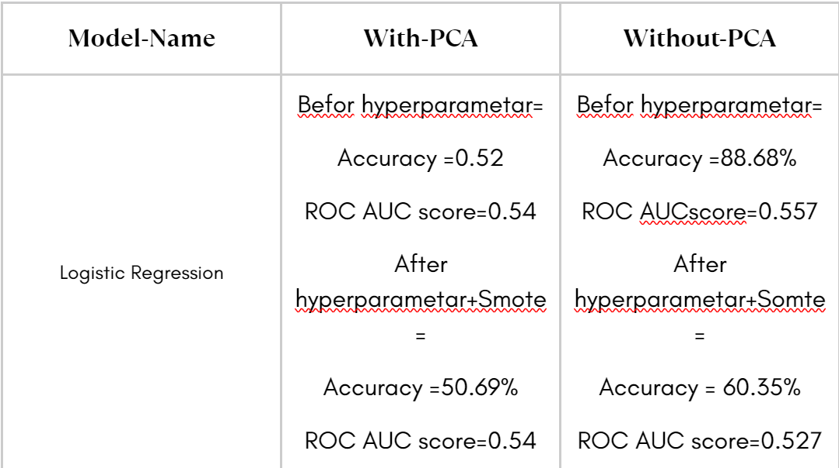
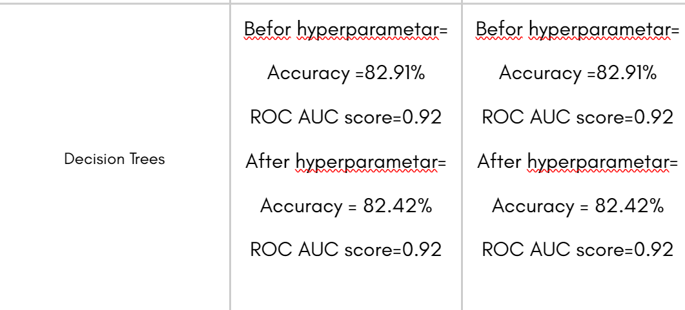
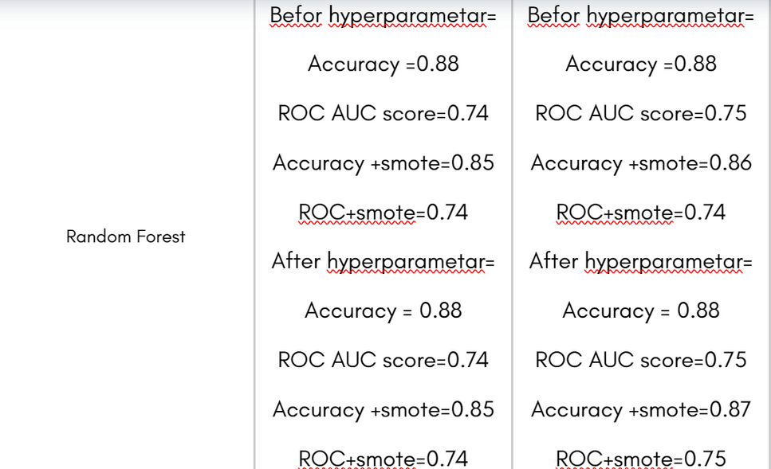
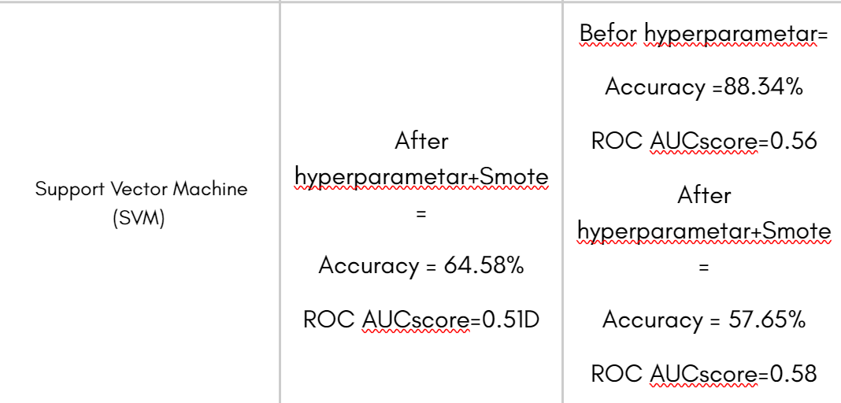

Slide 9
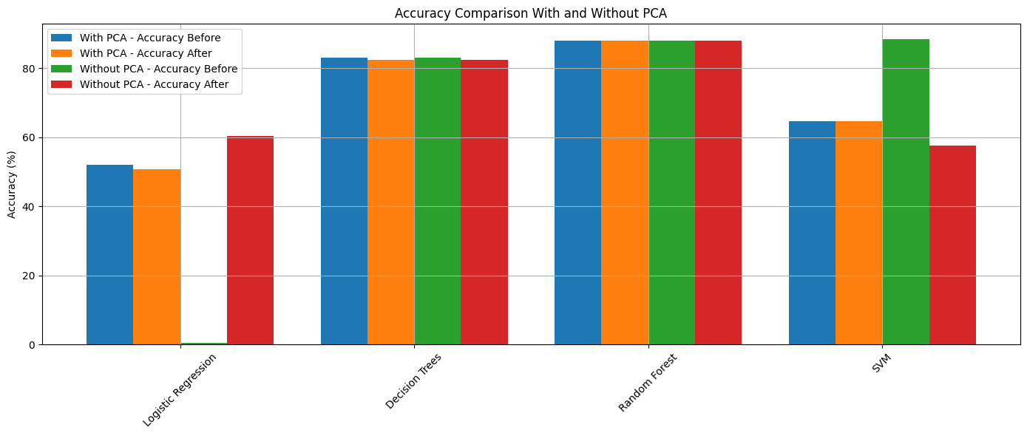

Slide 10


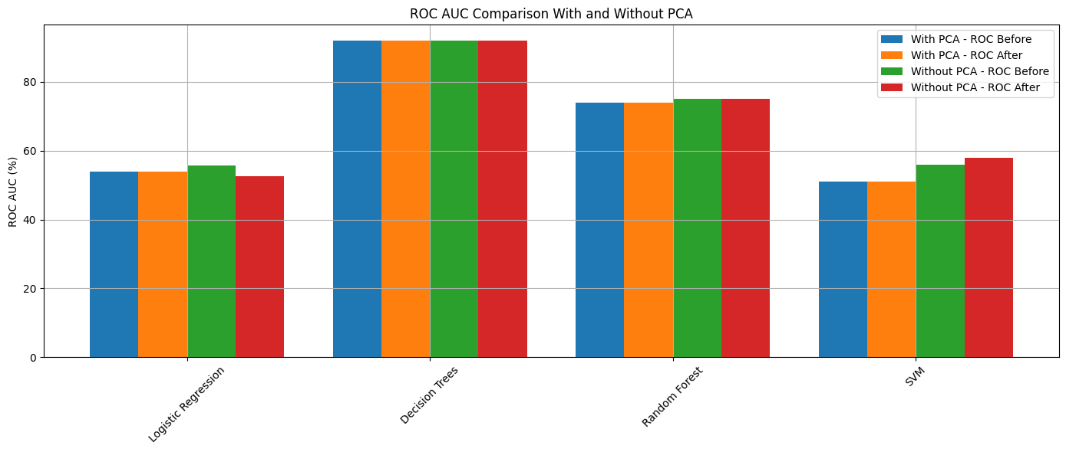



Slide 11

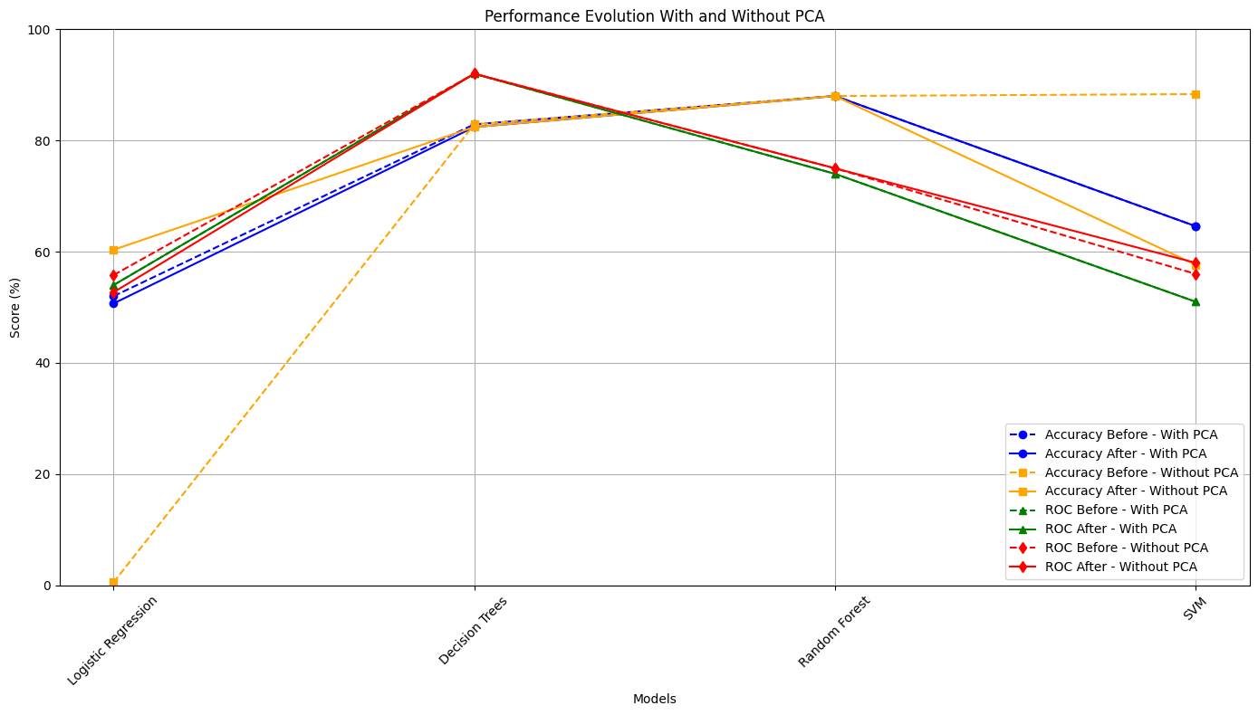


Slide 12


Logistic Regression
Goal: Build a Logistic Regression model to predict credit card eligibility (STATUS: 0=eligible, 1=not eligible) using data
Steps:
3-Dimensionality Reduction:
Apply PCA (10 components) to reduce data dimensions.
1-Load Data:
Read Final-Merge-PCA.csv.
Split into:
X: Features (excluding STATUS, ID, MONTHS_BALANCE).
y: Target (STATUS).
4-Train Initial Model:
Use Logistic Regression with class_weight='balanced'.
Train and test the model.
Accuracy: 52.63%.
Issue: Poor performance on class 1 due to class imbalance.
2-Split Data:
80% training, 20% testing using
5-Evaluate Model:
Compute Precision, Recall, F1-Score.
Visualize Confusion Matrix and ROC Curve (ROC AUC: 0.5442).

Slide 13
Logistic Regression
6-Handle Class Imbalance:
Use SMOTE to generate synthetic samples for class 1.
Reapply PCA and retrain the model.
7-Optimize Model:
Use RandomizedSearchCV to tune parameters (C, solver, class_weight).
Accuracy: 50.69% (slight improvement for class 1).
Results:
Model biased toward class 0 due to imbalance.
SMOTE and RandomizedSearchCV slightly improved class 1 performance, but overall accuracy is low.
8-Evaluate Optimized Model:
Visualize Confusion Matrix, ROC Curve, and compare Precision, Recall, F1-Score.
Suggestions:
Try other models (Random Forest, XGBoost).
Adjust PCA or preprocess data better.
Explore other imbalance techniques.

Slide 14
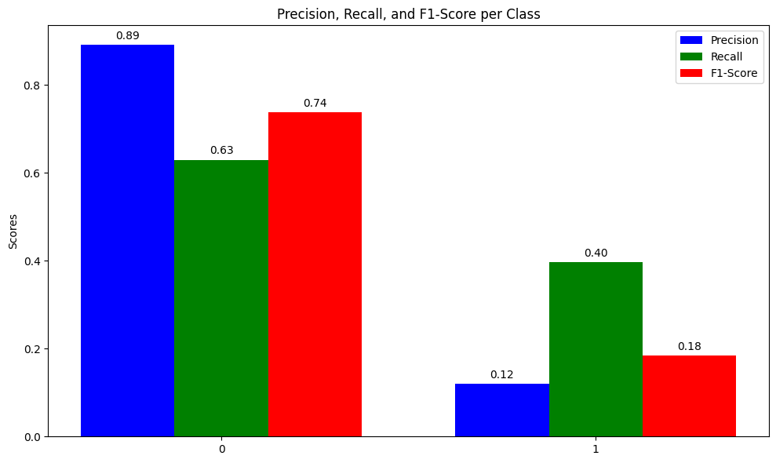
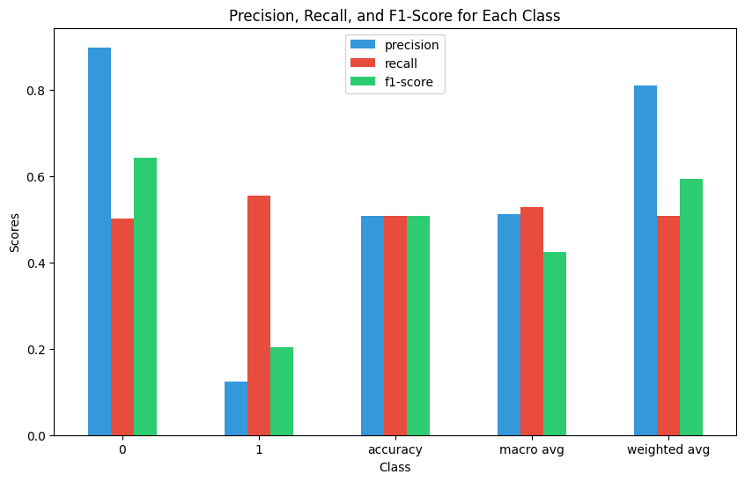

Logistic Regression

Slide 15



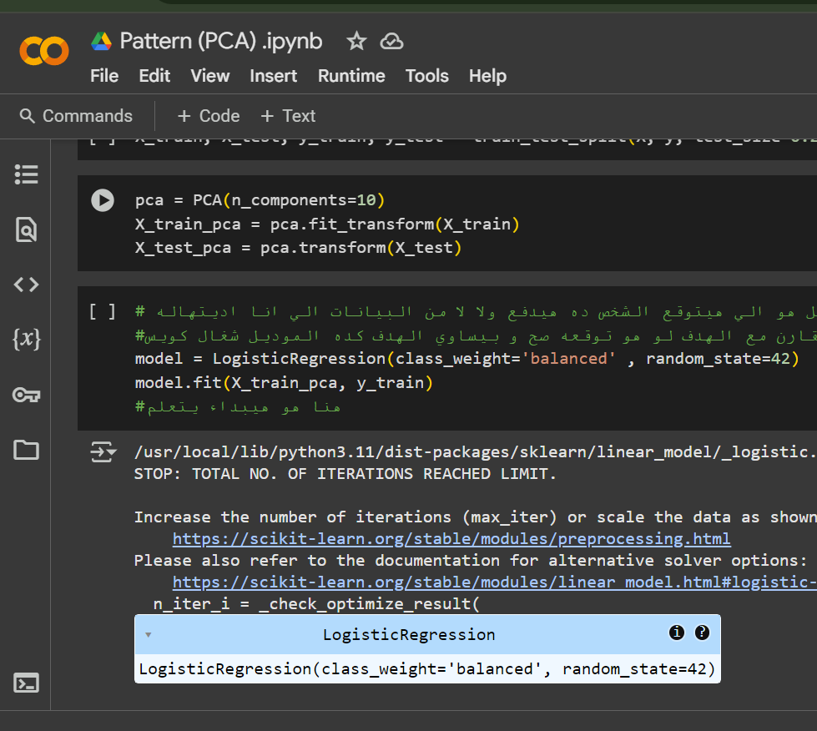

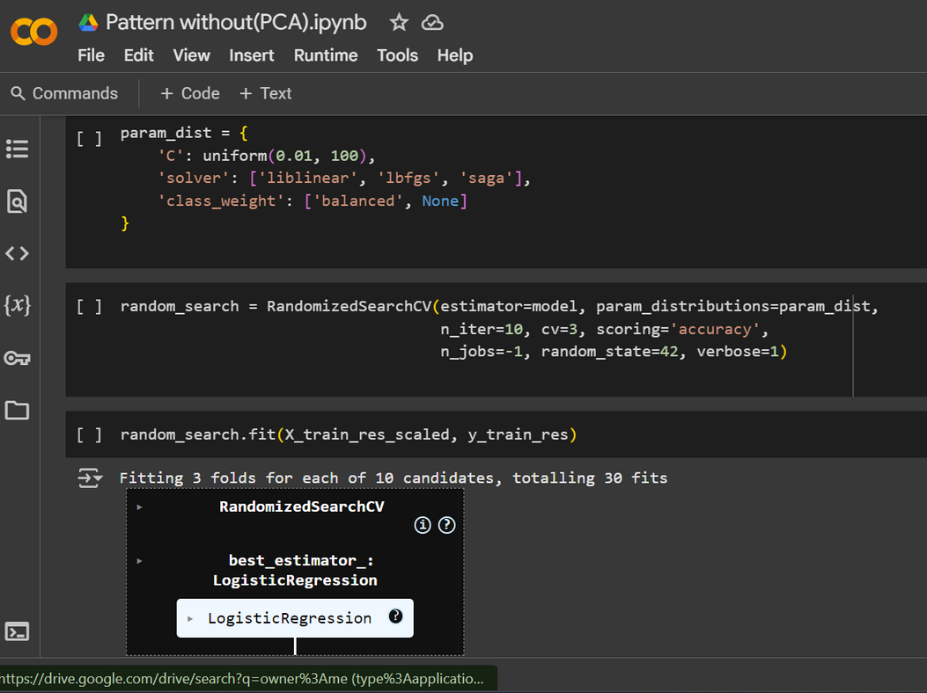



Slide 16



Decision Tree
The code uses a **Decision Tree Classifier** to predict credit card approvals:
1. **Data Loading**: Loads data from Google Drive, processes it, and creates binary labels (0/1) based on payment status.
2. **Preprocessing**: Splits data into train (80%) and test (20%), selects top 10 features using feature importance.
3. **Tuning**: Optimizes hyperparameters with `RandomizedSearchCV` (5-fold CV).
4. **Evaluation**: Tests the model, plots accuracy, confusion matrix, ROC curve, and cross-validation scores.
5. **Saving**: Saves the best model and visualizes hyperparameter effects.

Slide 17


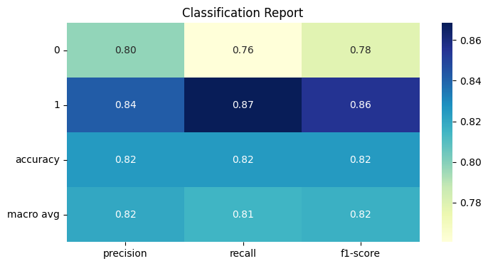


Decision Tree

Slide 18


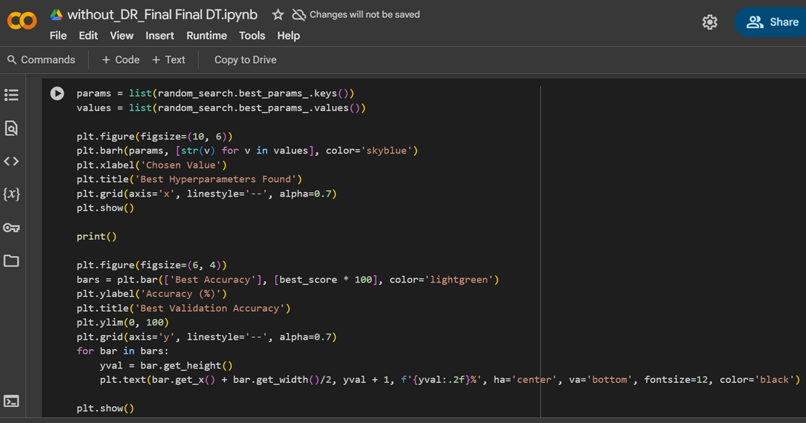
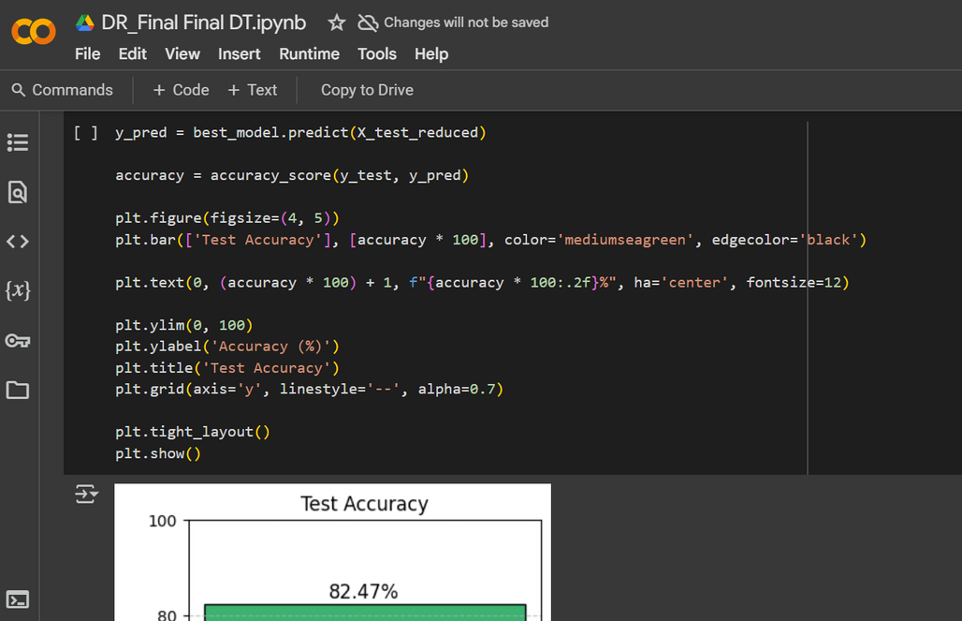
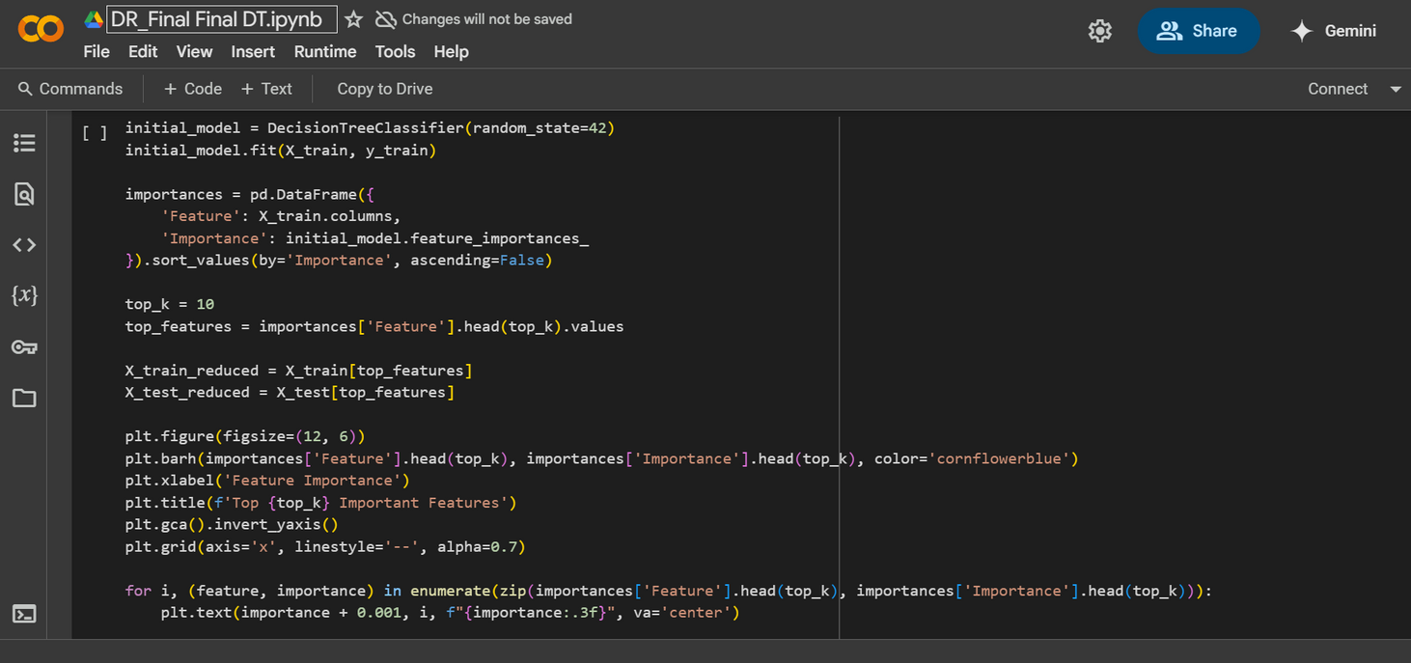



Slide 19




This evaluates a Random Forest classifier on PCA-transformed data and other time without PCA-transformed data, using GridSearchCV for hyperparameter tuning. It also stores or loads the best parameters from a JSON file to avoid retraining unnecessarily.
-First: we define the grid of hyperparameters for the RandomForestClassifier to try during tuning
-Second: Load Best Parameters if Available using the JSON file
-Third: Perform Grid Search if no JSON file exist , after the training is done it is saved to the JSON file
-Finally we evaluate using f1-score, accuracy, ROC AUC score and classification report
-we take into account that the data that isn’t PCA-TRANSFORMED we first perform Standard scaling on data
-Also the code covers the process of using SMOTE to try eliminate the class imbalance in the data
Random Forest :

Slide 20

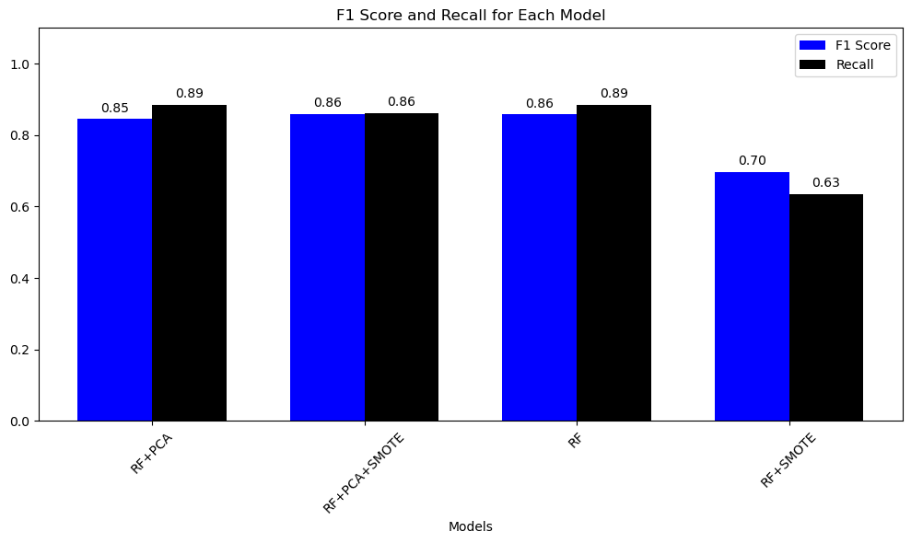



Random Forest

Slide 21


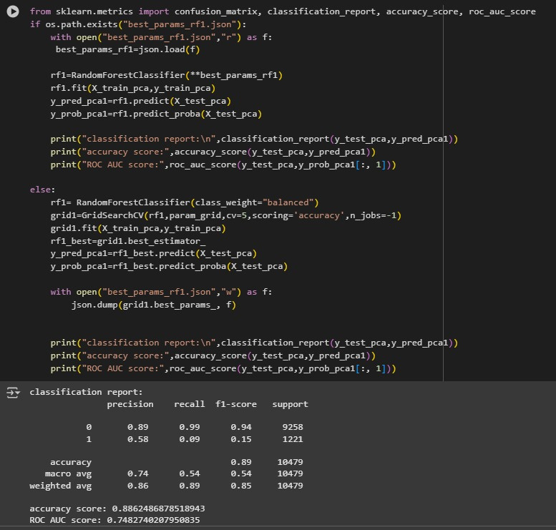
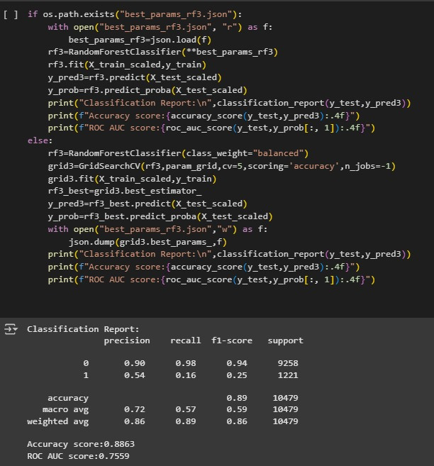


Slide 22




SVM
🧠 SVM Model for Credit Card Approval Prediction (Without PCA)
1. Data Loading & Cleaning
Loaded the dataset and dropped missing values.
2. Data Encoding
Converted categorical columns to numerical using LabelEncoder.
3. Train-Test Split
Split data into training (80%) and testing (20%).
4. Feature Scaling
Normalized features using StandardScaler.
5. Baseline Model Training
Trained an initial SVM model using SVC without any data balancing or parameter tuning.
Evaluated the base model performance using accuracy and confusion matrix.
6. Handling Imbalanced Data
Applied SMOTE (Synthetic Minority Over-sampling Technique) to balance the dataset.

Slide 23

SVM
7. Hyperparameter Tuning
Used GridSearchCV to find the best values for key parameters like:
C (regularization)
kernel (e.g., linear, rbf)
gamma (kernel coefficient)
8. Final Model Evaluation
Re-trained the model using the best parameters on the balanced data.
Achieved improved performance, evaluated using accuracy and confusion matrix.

Slide 24




SVM
🧠 SVM Model for Credit Card Approval Prediction (With PCA)
1. Data Preparation
Loaded the dataset, cleaned it by removing missing values.
Encoded categorical variables using LabelEncoder.
2. Train-Test Split & Scaling
Split the data into training and testing sets (80/20).
Applied StandardScaler to normalize feature values.
3. Dimensionality Reduction
Applied PCA (Principal Component Analysis) to reduce the number of features while keeping most of the variance.
Helped to simplify the model and reduce overfitting.
4. Baseline Model Training
Trained an initial SVM model (using SVC) on PCA-transformed data.
Evaluated the basic model performance without SMOTE or tuning.
5. SMOTE Oversampling
Used SMOTE to balance the dataset (especially for minority class).

Slide 25
SVM
6. Hyperparameter Tuning
Applied GridSearchCV to optimize SVM parameters:
C, kernel, and gamma
Trained a final model with the best parameters on the SMOTE-balanced data.
7. Final Evaluation
Evaluated the tuned model using accuracy and confusion matrix.
Observed improved performance compared to the baseline.

Slide 26



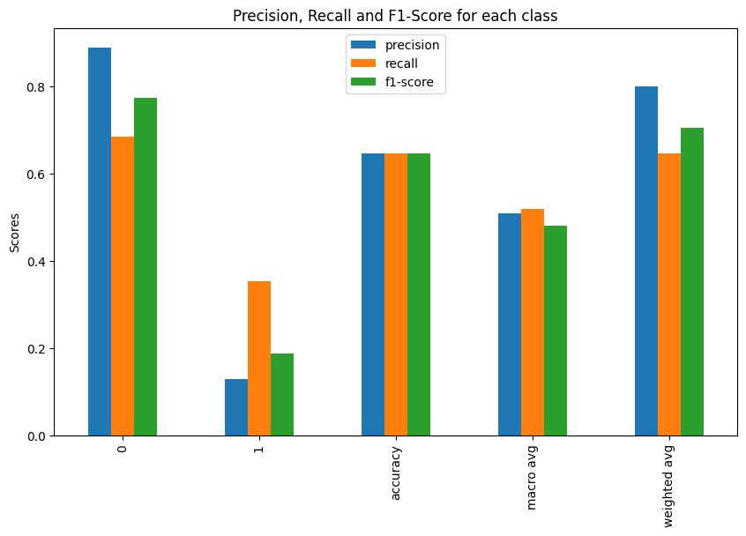

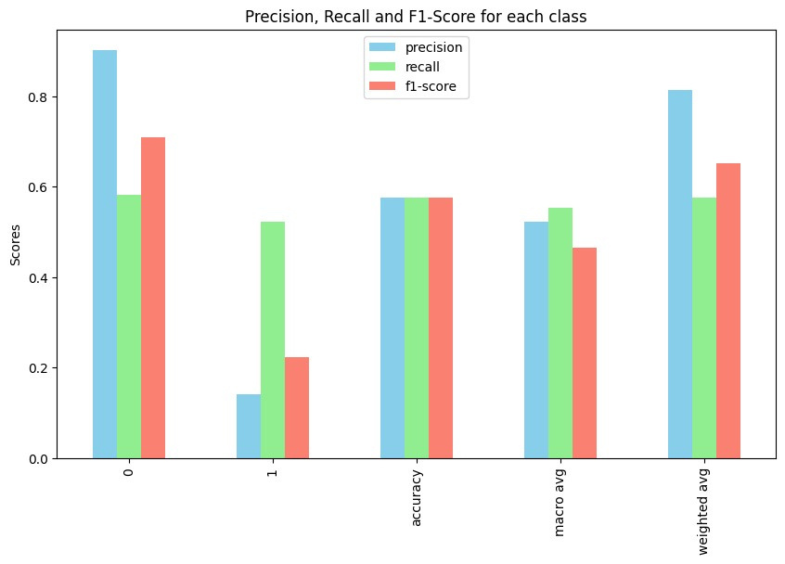



SVM

Slide 27

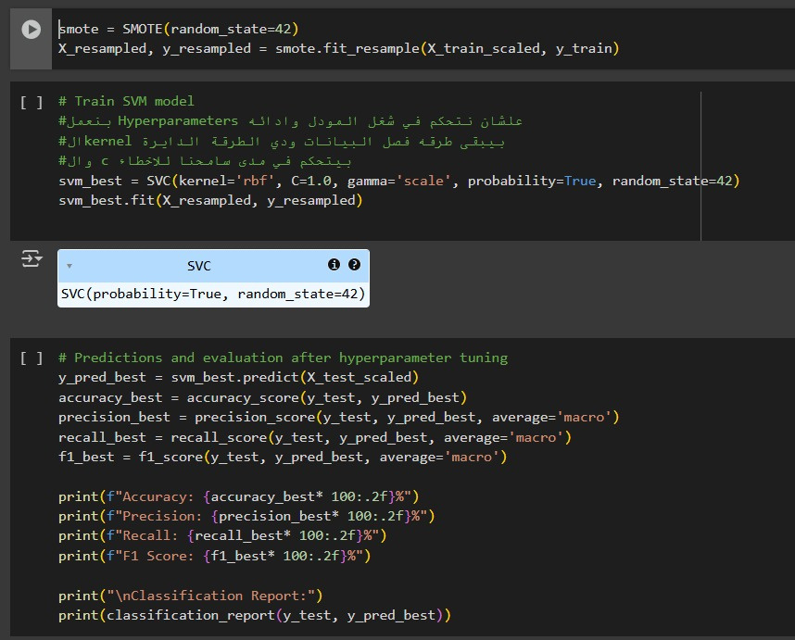
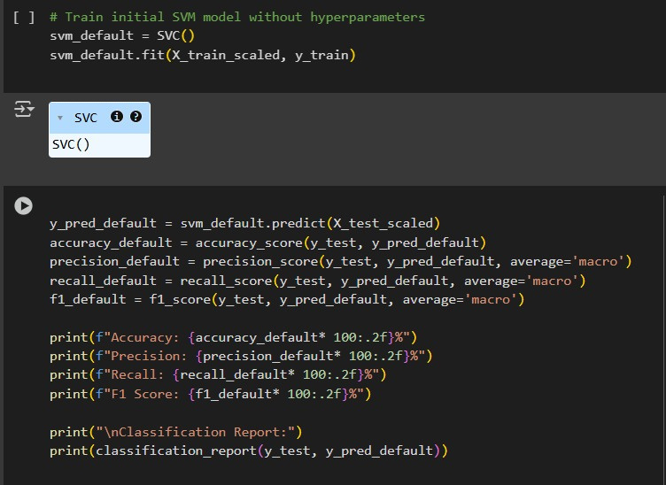
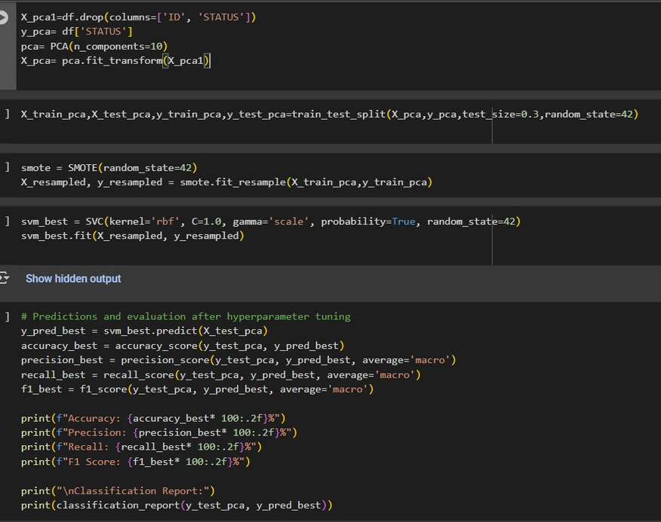



Slide 28

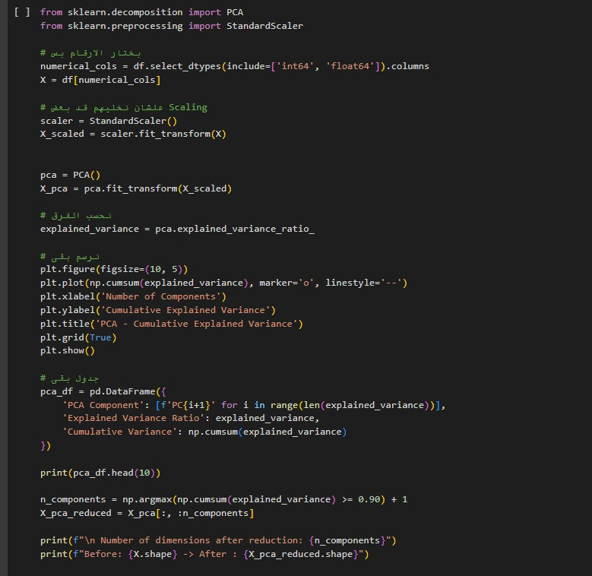
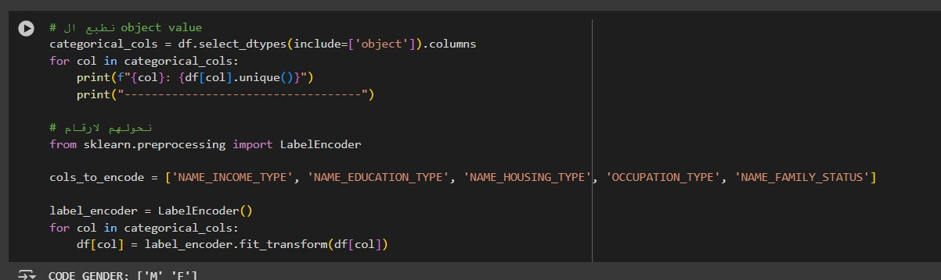
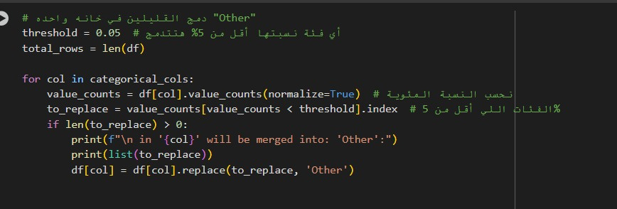


Slide 29




Thank You
Razan mohamed kamal
2200367
Shahinaz samy mohamed
2200369
Yasmin Walid Shaltout
2200392
Aliaa Mohamed
2200393
Hanan Hassan Hussein
2200966
Mohamed Adel Mousa
2200787

